Slide 1

National University of Computer and Emerging Sciences
Generative Adversarial Networks
AI-4009 Generative AI
Dr. Akhtar Jamil
Department of Computer Science

Slide 2
Goals
Review of Previous Lecture
Today’s Lecture
Problems Training GANs
DCGANs

Slide 3
Review of Previous Lecture

Slide 4
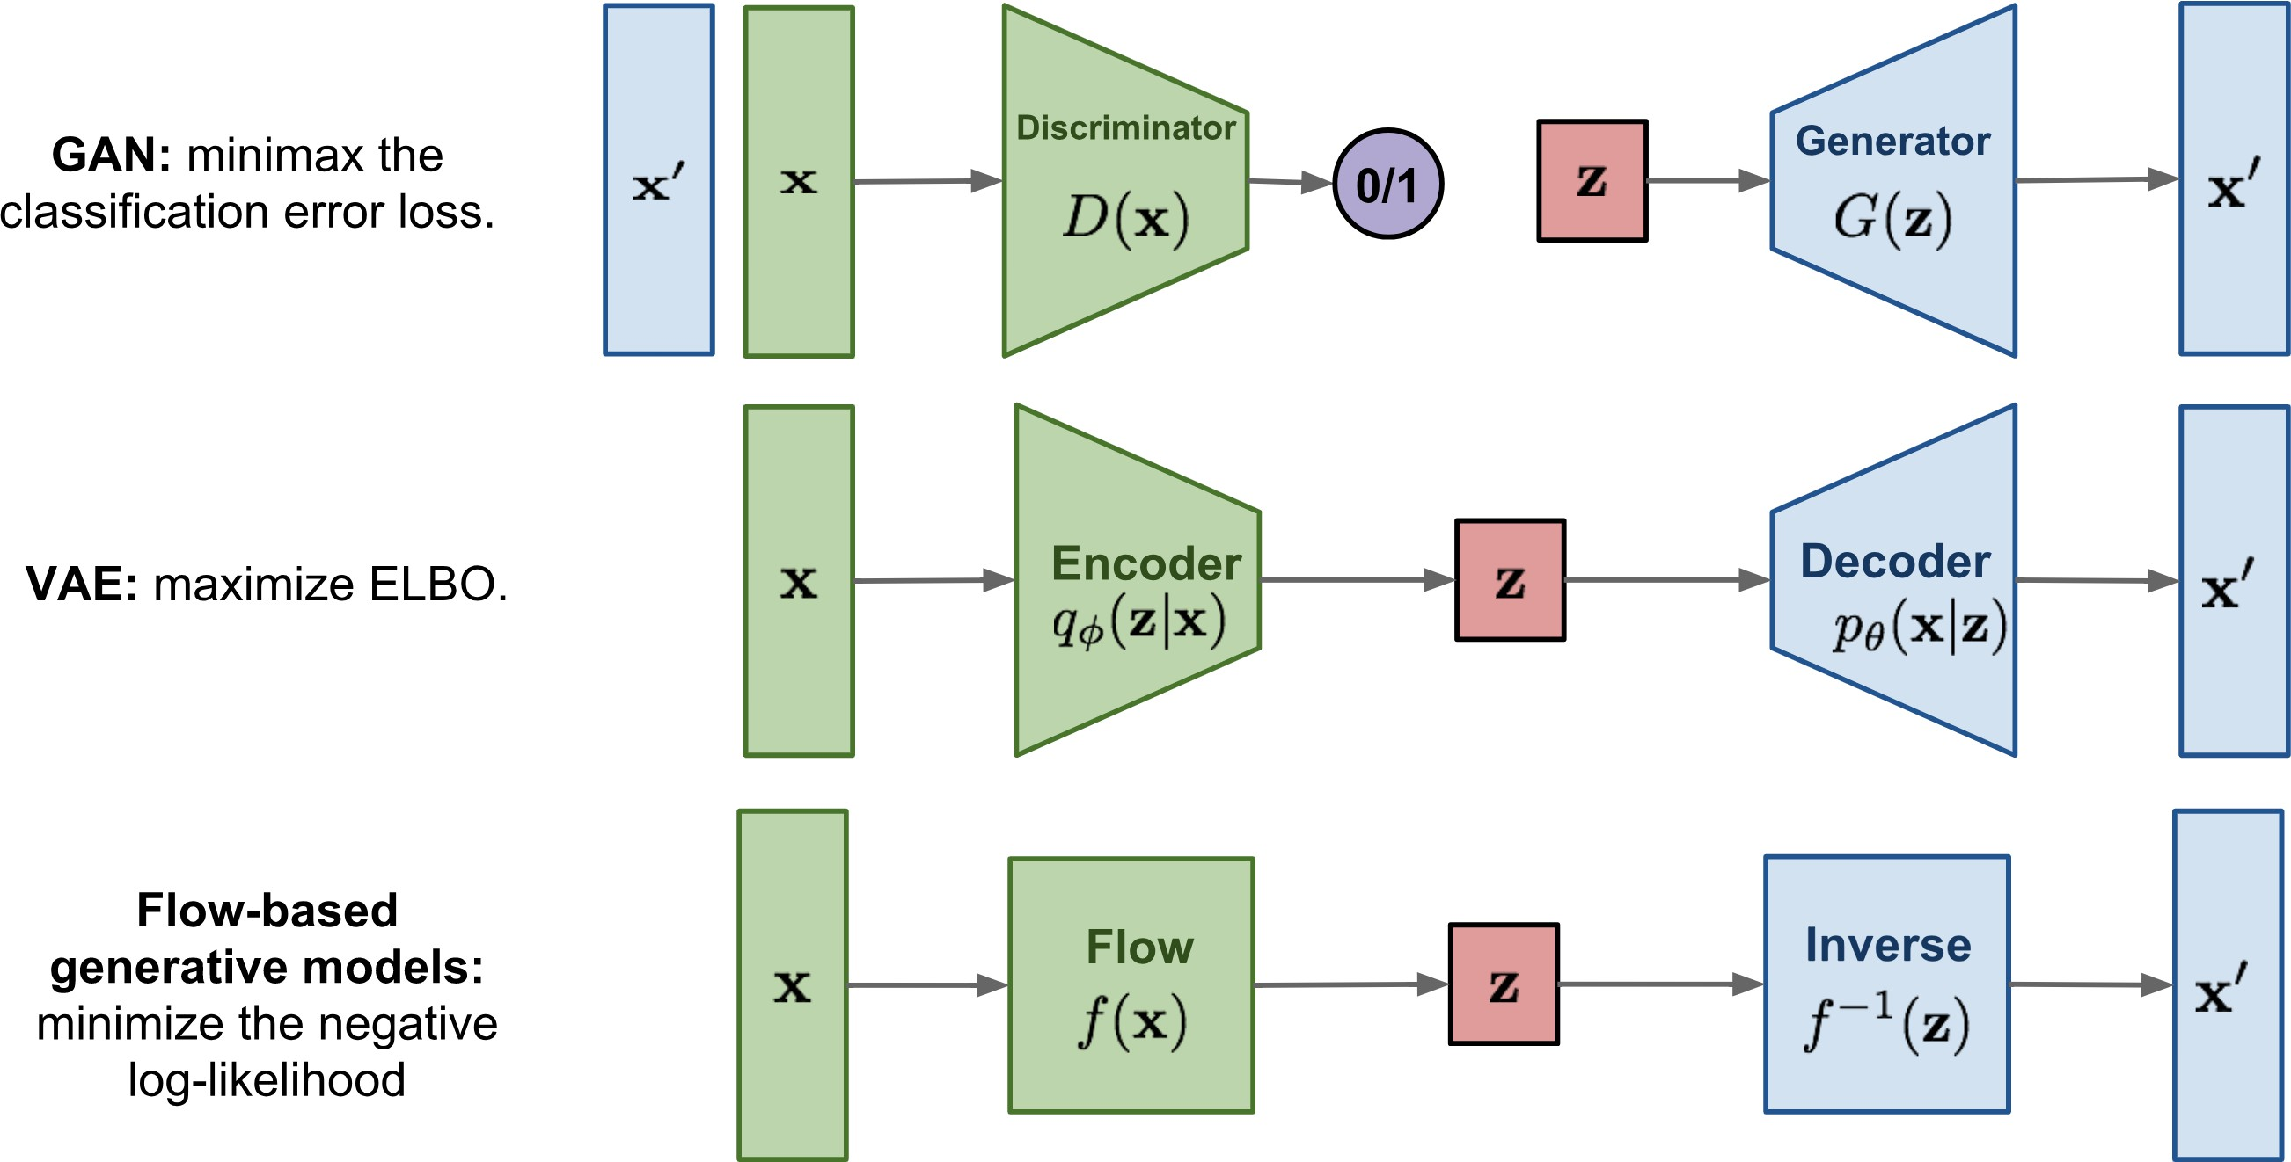
Types of Generative Models
Lilian Weng, "Flow-based Deep Generative Models," blog post, 2018.

Slide 5
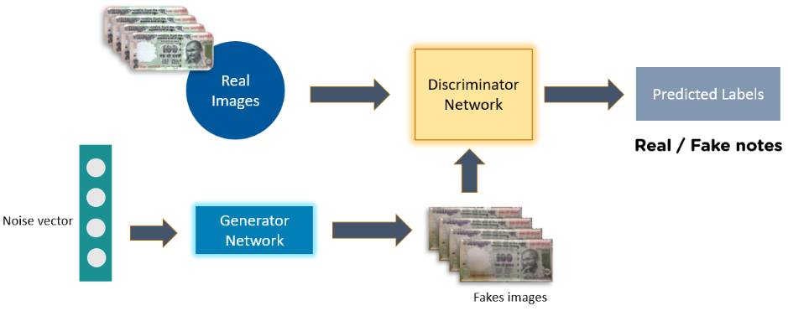
Generative Adversarial Network
Complete GAN Network

Slide 6
GAN Training
Because a GAN contains two separately trained networks, its training algorithm must address two complications:
GANs must switch two different kinds of training (generator and discriminator).
GAN convergence is hard to identify.
Alternating Training
The discriminator trains for one or more epochs.
The generator trains for one or more epochs.
Repeat steps 1 and 2 to continue to train the generator and discriminator networks.

Slide 7
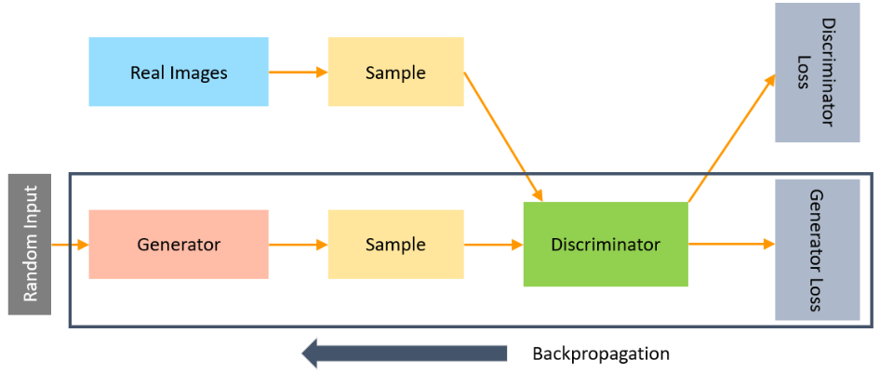
Generative Adversarial Network
The backpropagation method is used to adjust each weight in the right direction by calculating the weight's impact on the output.

Slide 8
Loss Functions
Minimax Loss

Slide 9
Today’s Lecture

Slide 10
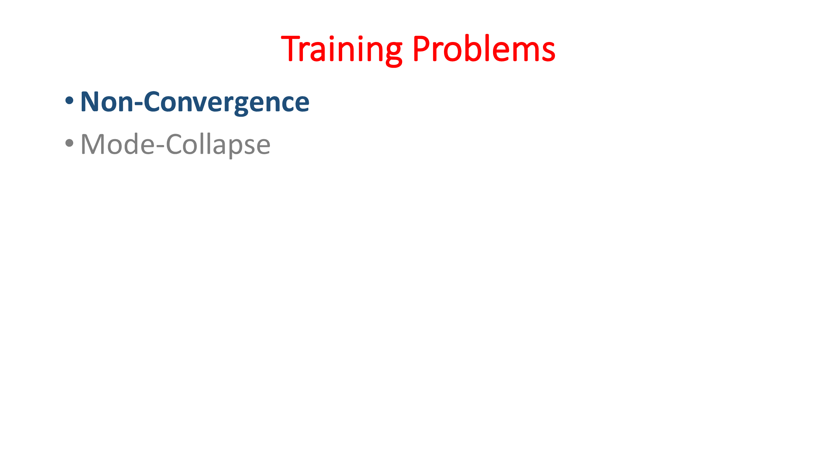

Slide 11
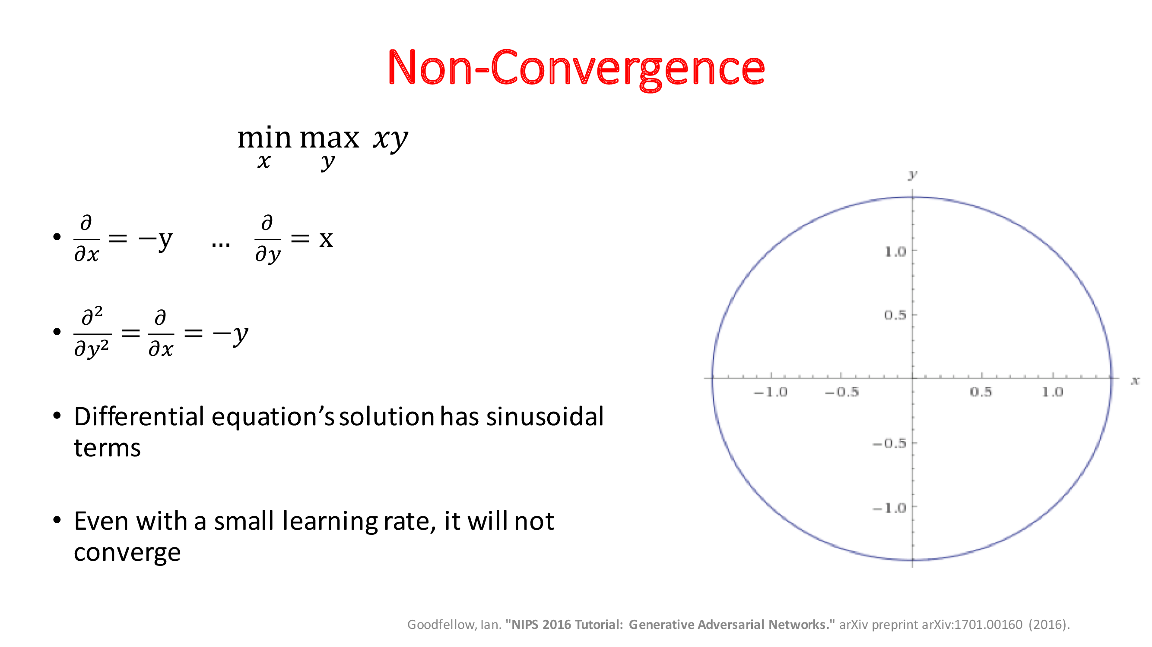

Slide 12
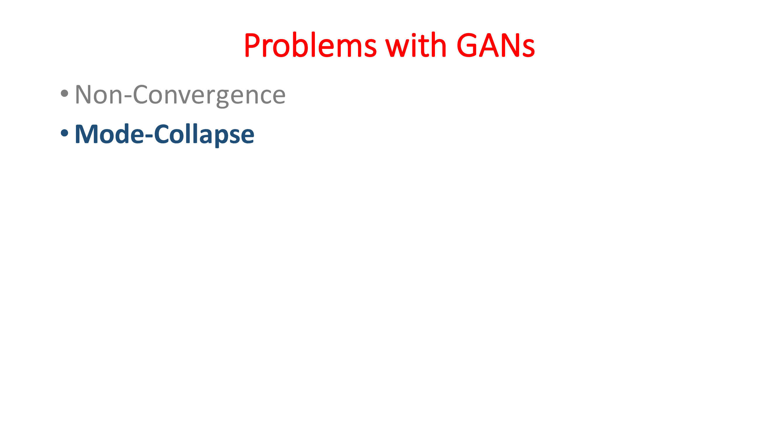

Slide 13
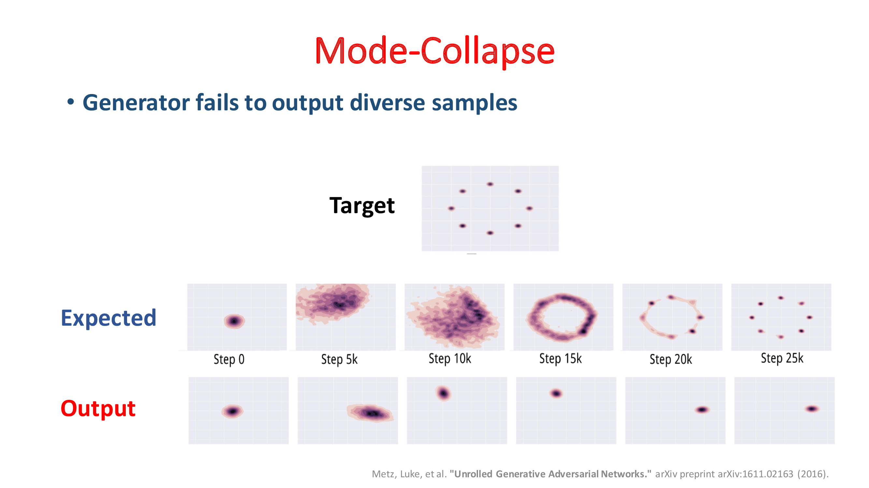

Slide 14
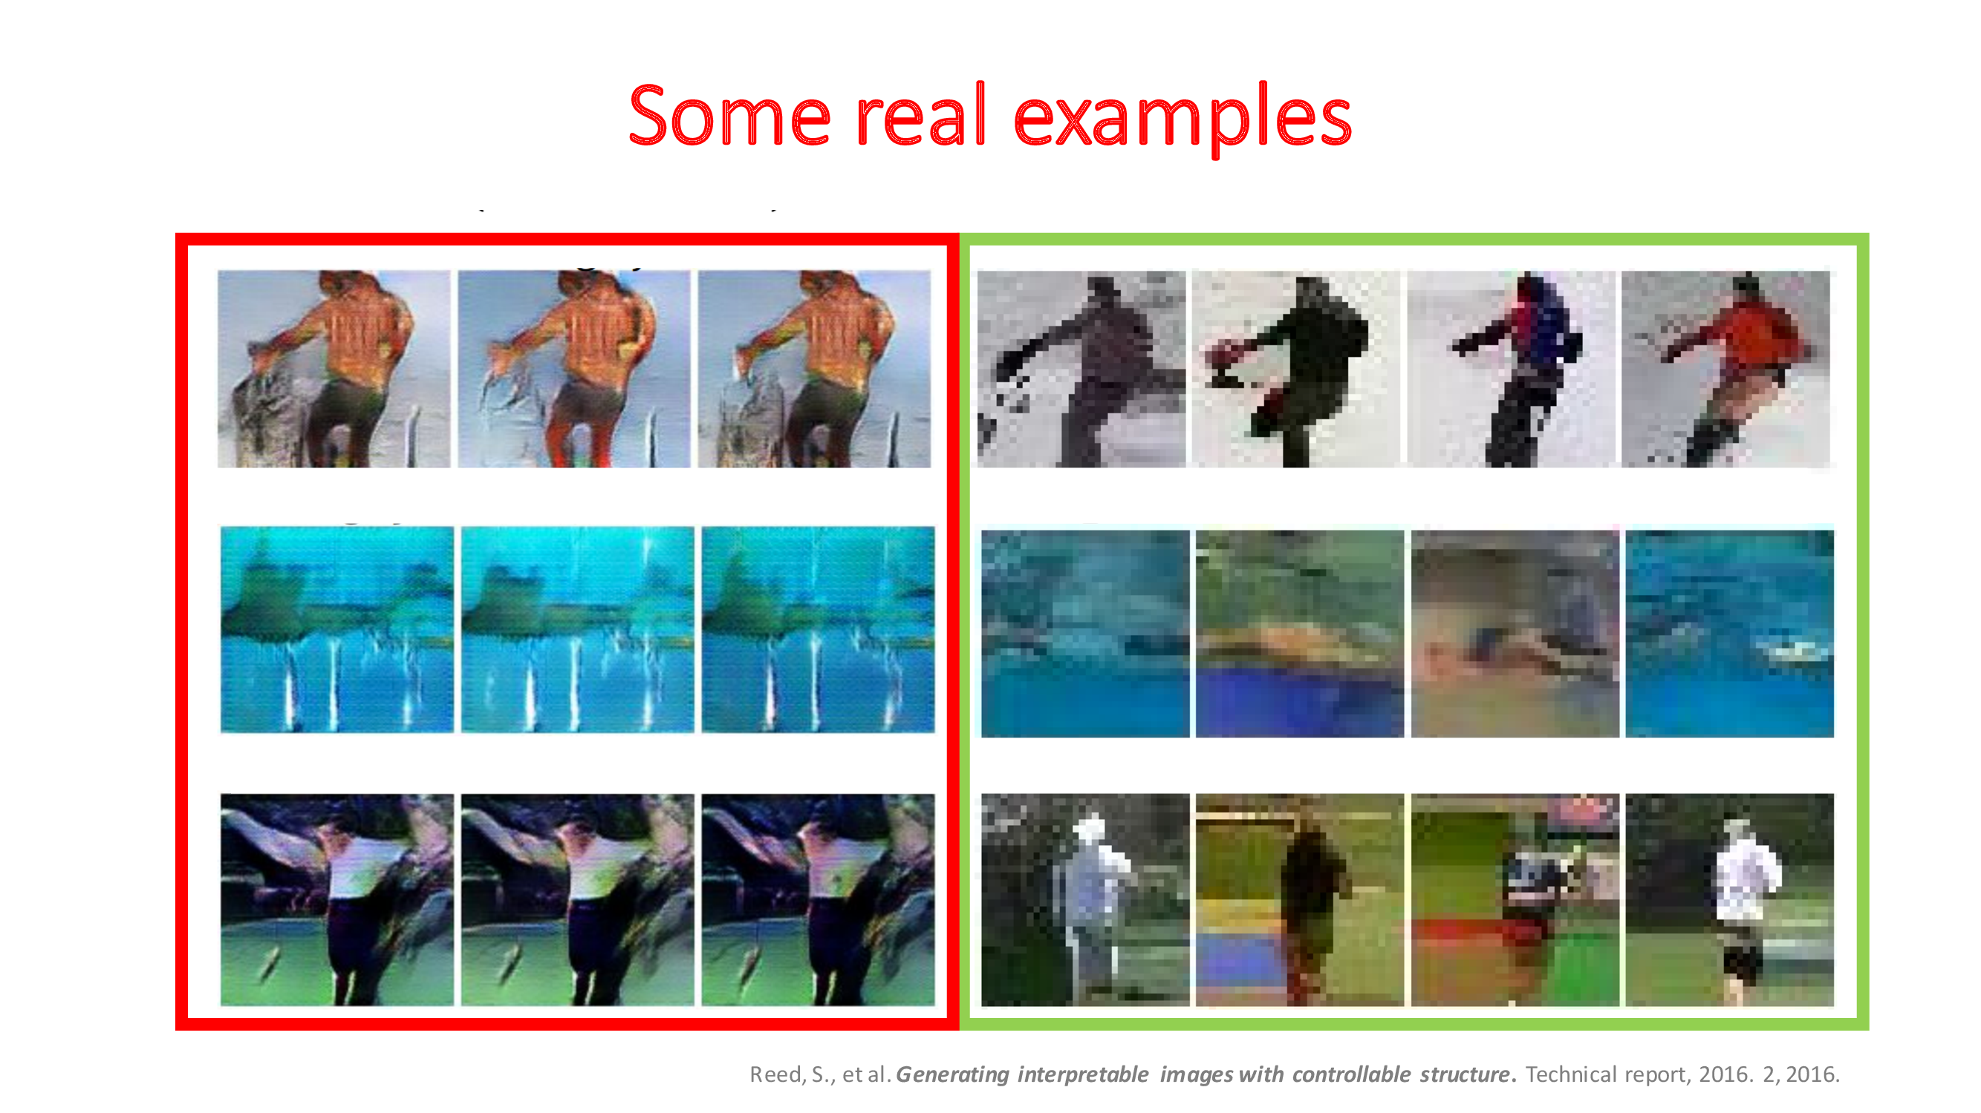

Slide 15
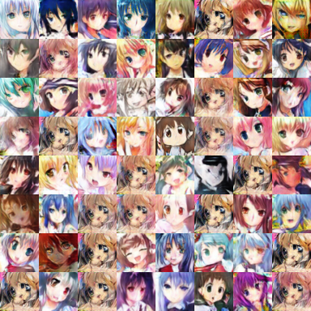
Mode Collapse
Converge to same faces
Generated Distribution
Data Distribution
Sometimes, this is hard to tell since
one sees only what’s generated, but not what’s missed.

Slide 16
Solutions
Use Mini Batch GANs
Supervision with Labels

Slide 17
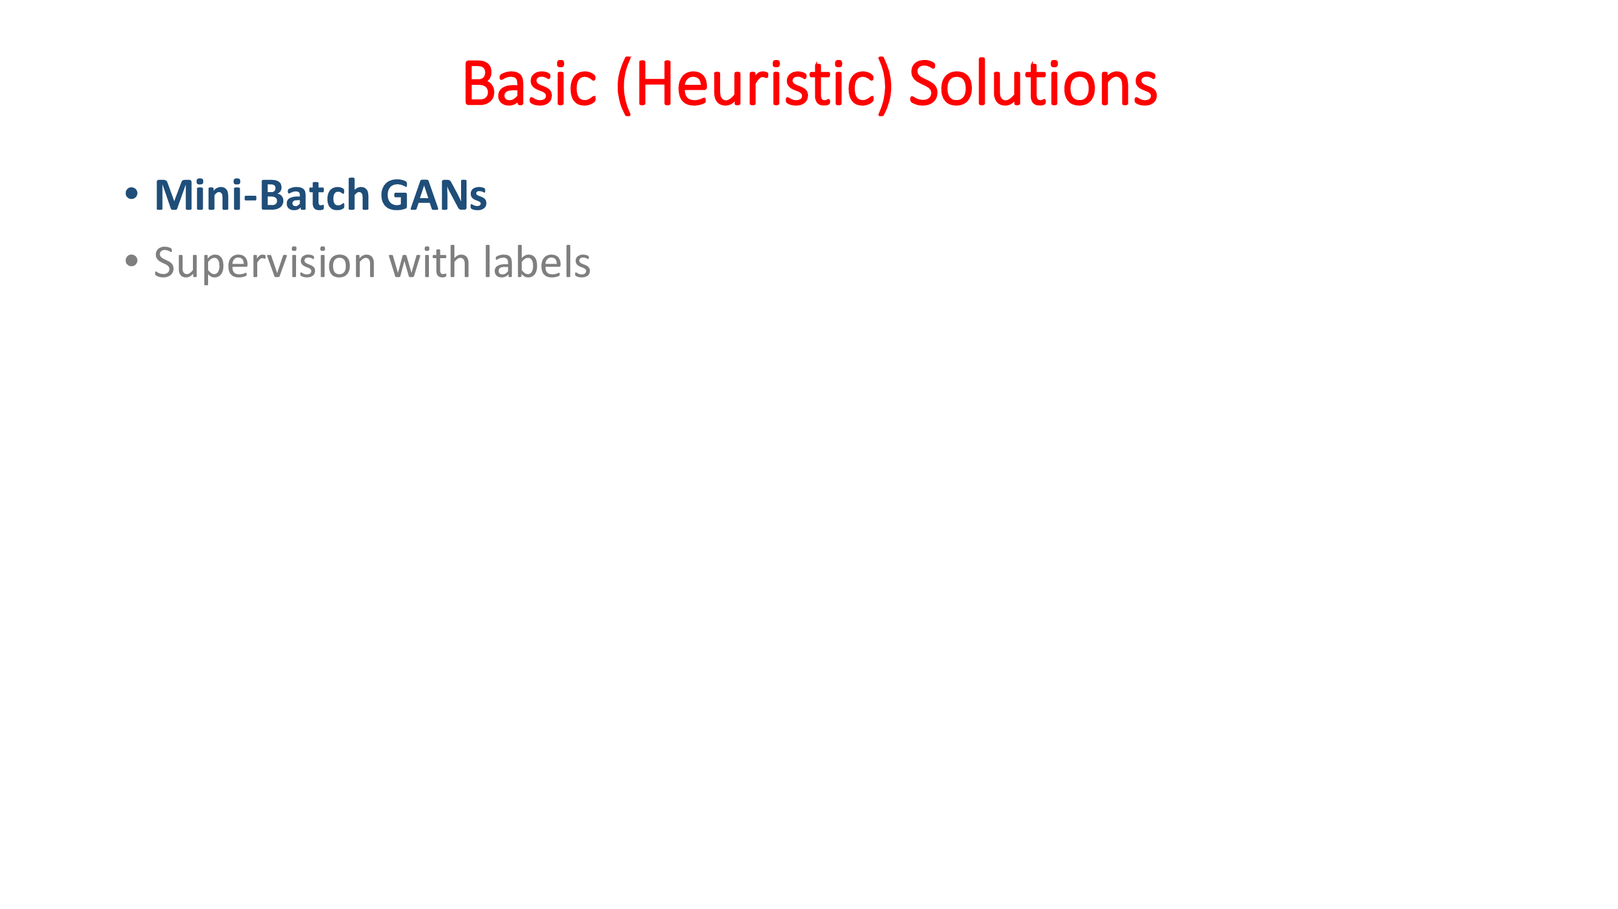

Slide 18
Mini Batch Generative Adversarial Networks (Mini Batch GANs)
Mini Batch GANs are a variation of Generative Adversarial Networks (GANs).
In traditional GANs, the discriminator evaluates each sample individually to decide whether it is real or fake.
In Mini Batch GANs, the discriminator evaluates samples in small groups or "mini-batches".
Concept called mini-batch discrimination
Assess the authenticity of individual samples but also the diversity between samples within a batch.

Slide 19
Mini Batch GANs on MNIST
Deconv
Tanh/Sigmoid
Conv, BN,
LReLU
Conv, BN,
LReLU
Reshape,
FC, BN,
LReLU
FC,
Sigmoid
FC, BN,
Reshape
Deconv
BN, ReLU
100
7x7x16
14x14x8
28x28x1
14x14x8
7x7x16
256
1
Generator
Discriminator

Slide 20
Mini Batch GANs
Generator in Batches
The generator can produce batches of images at once instead of single images.
Processing in batches allows for more efficient computation.
More diversity of samples being evaluated by the discriminator, facilitating a more comprehensive training.
Mini-batch Discrimination
The discriminator uses a measure to assess how much the generated samples deviate from the real samples within the same batch.
Computing distances or similarities between samples in the feature space.
How diverse the generated images are within each batch (mode collapse).

Slide 21
Mini Batch GANs
Backpropagation:
Based on the discriminator’s feedback the GAN updates both the generator and discriminator.
The generator learns to produce more diverse and realistic samples
Iteration:
This process repeats over many cycles
The generator and discriminator iteratively improving in response to each other's feedback.

Slide 22

Mini Batch GANs
For standard Discriminator in GAN:
$$L_{D}=−\frac{1}{N}\sum_{i=1}^{N}{\left[y_{i}\log\left(D\left(x_{i}\right)\right)+\left(1−y_{i}\right)\log\left(1−D\left(G\left(z_{i}\right)\right)\right)\right]}$$
For Generator:
$$L_{G}=−\frac{1}{N}\sum_{i=1}^{N}{\log\left(D\left(G\left(z_{i}\right)\right)\right)}$$

Slide 23
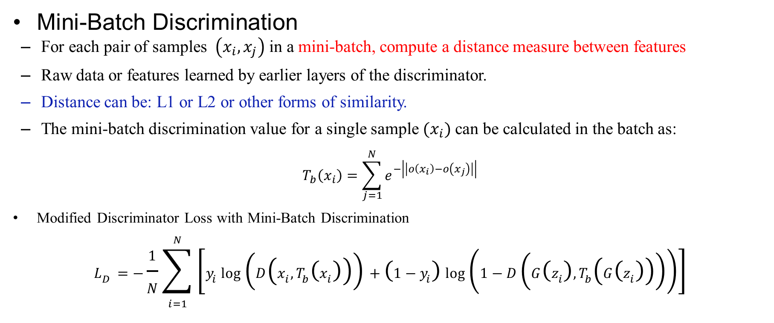
Mini Batch GANs
Mini-Batch Discrimination
For each pair of samples $\left(x_{i},x_{j}\right)$ in a mini-batch, compute a distance measure between features
Raw data or features learned by earlier layers of the discriminator.
Distance can be: L1 or L2 or other forms of similarity.
The mini-batch discrimination value for a single sample $(x_{i})$ can be calculated in the batch as:
$$T_{b}\left(x_{i}\right)=\sum_{j=1}^{N}{e^{−\left|\left|o\left(x_{i}\right)−o\left(x_{j}\right)\right|\right|}}$$
Modified Discriminator Loss with Mini-Batch Discrimination
$$L_{D}=−\frac{1}{N}\sum_{i=1}^{N}{\left[y_{i}\log\left(D\left(x_{i},T_{b}\left(x_{i}\right)\right)\right)+\left(1−y_{i}\right)\log\left(1−D\left(G\left(z_{i}\right),T_{b}\left(G\left(z_{i}\right)\right)\right)\right)\right]}$$

Slide 24
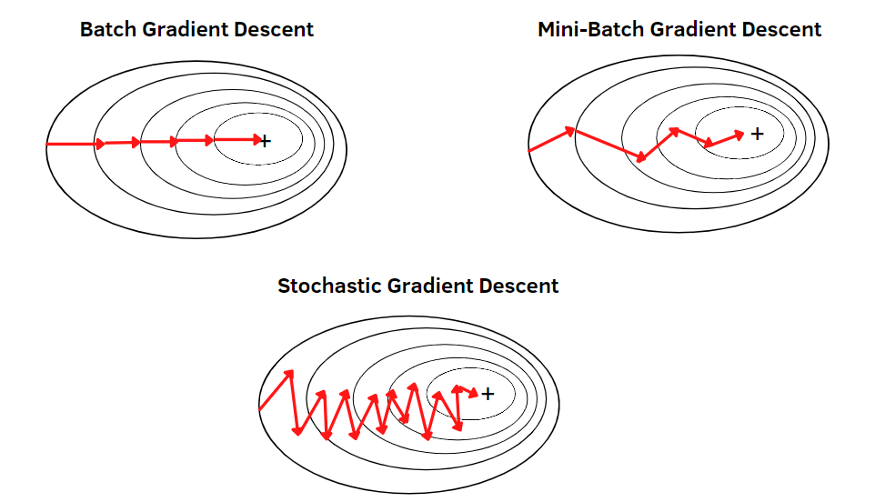
Advantages of Mini Batch GANs
Mini Batch GANs encourage the generator to produce a diverse range of outputs.
Stable training as the discriminator works on a batch instead of individual samples.
Mini batches can lead to faster convergence of the network
Mini-batch discrimination provides more information to the generator, which can help in generating higher-quality samples.

Slide 25
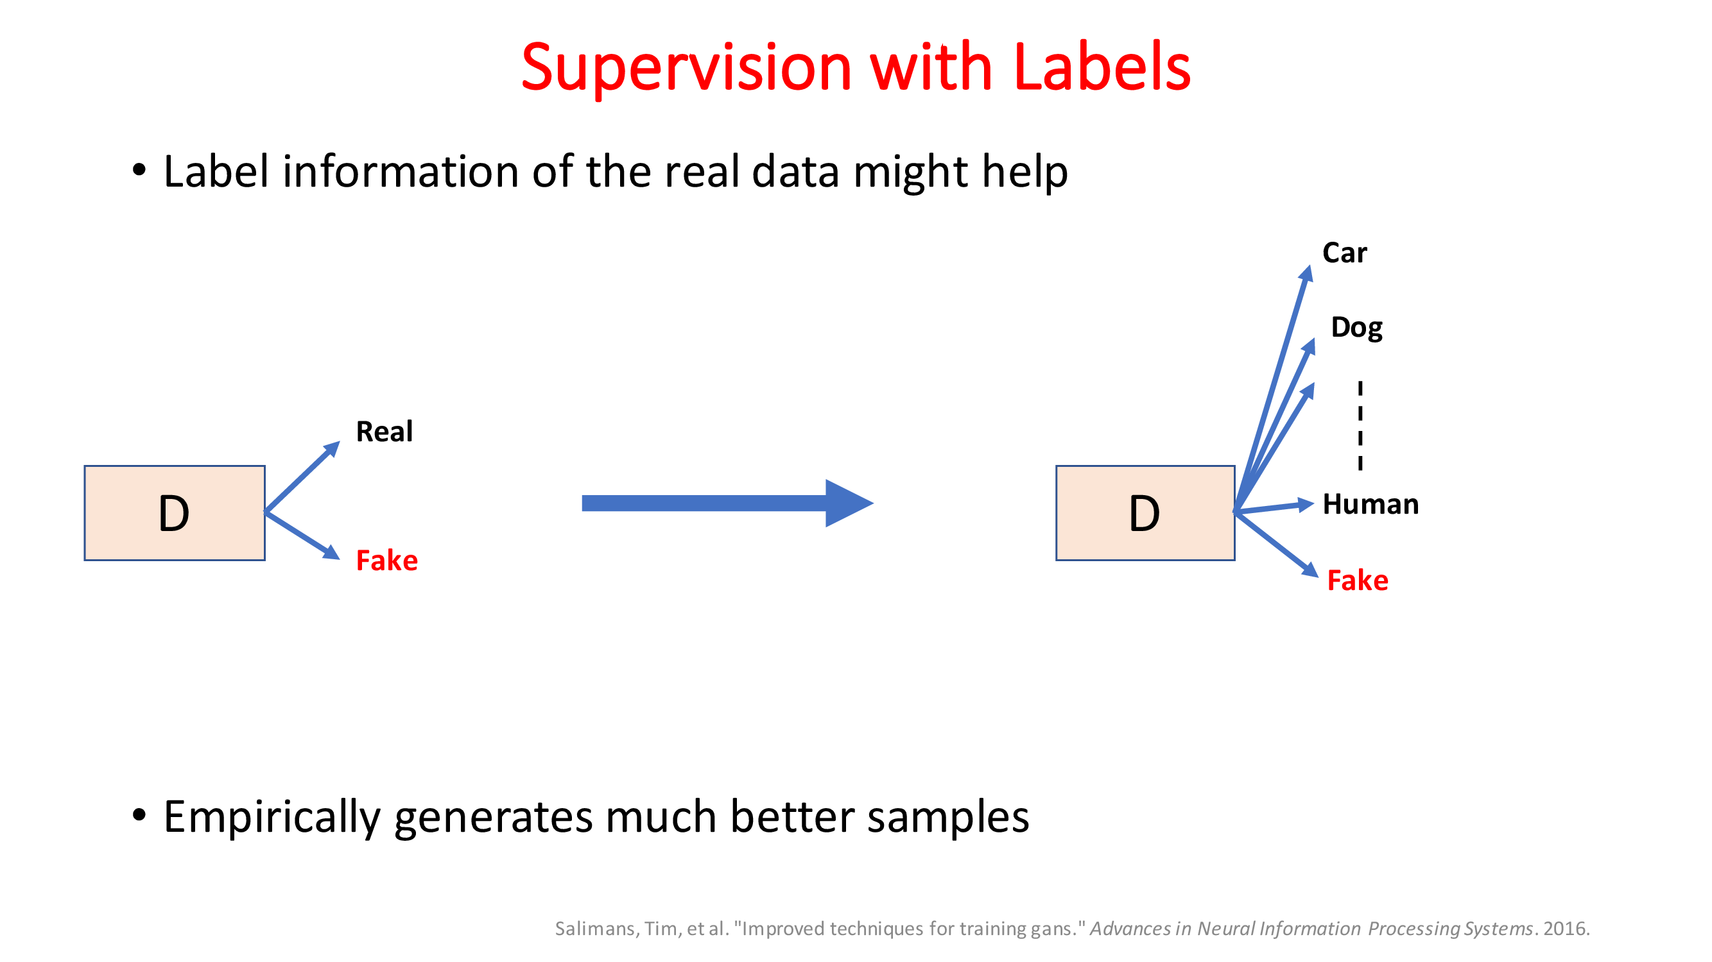

Slide 26
Unsupervised Representation Learning with Deep Convolutional Generative Adversarial Networks

Slide 27
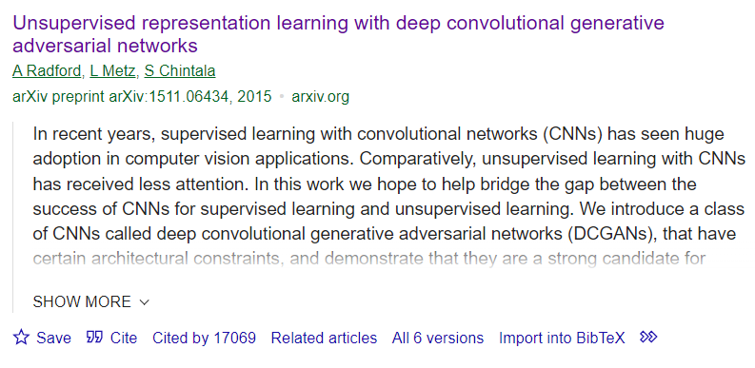
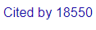
DCGAN

Slide 28
DCGANs
DCGAN: Download Paper.
Supervised learning with convolutional networks (CNNs) has seen huge adoption in computer vision applications
Comparatively, unsupervised learning with CNNs has received less attention
CNN for unsupervised learning
DCGANs builds upon the original Generative Adversarial Networks (GANs) by incorporating convolutional layers, making them more suited for image processing

Slide 29
DCGANS
DCGANs consist of two main components:
Generator: This network generates new data instances (e.g., images) from random noise.
It typically uses transposed convolutional layers to progressively upsample the input noise to an image.
Discriminator: This network evaluates the authenticity of images.
It takes an image (either from the training set or generated by the generator) and outputs the probability of the image being real (as opposed to being generated).

Slide 30
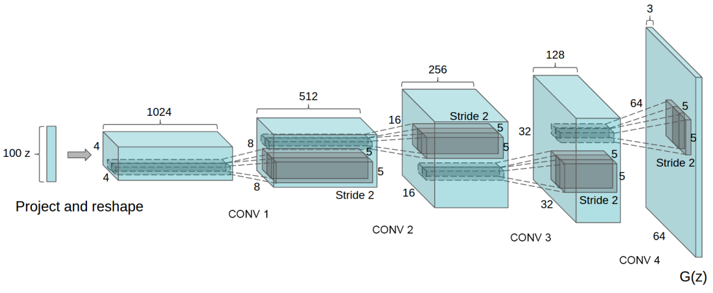
DCGANS

Slide 31
DETAILS OF ADVERSARIAL TRAINING
We trained DCGANs on three datasets:
Large-scale Scene Understanding (LSUN)
Imagenet-1k
Faces dataset.
No pre-processing was applied to training images besides scaling to the range of the tanh activation function [-1, 1].
LeakyReLU with the slope of the leak was set to 0.2.
Adam optimizer with tuned hyperparameters.
Learning rate set to 0.0002, momentum = 0.2

Slide 32
Image De-duplication Process
It is a method used to decrease the likelihood that GAN memorizes and directly replicates its training images
Model learns to understand and recreate the underlying data distribution without copying exact details.
Before deduplication, images from the training set are modified by cropping them to focus on the central region and then resizing them to a standard size of 32x32 pixels.
3072-128-3072 de-noising dropout regularized RELU autoencoder is used
Hidden code layer with 128 nodes.

Slide 33
Image De-duplication Process
Autoencoder compresses and then reconstructs the images, helping to remove noise and unnecessary details.
Binarization and semantic hashing:
After training, the latent spaces are used to represent each image.
Z are made binary (0 or 1) by thresholding: values above the threshold are set to 1, and those below are set to 0.
Result of binarization is like semantic hashing where similar images are likely to have similar binary codes, allowing for efficient comparison and deduplication.

Slide 34
Image De-duplication Process
De-duplication
Using these binary codes images are compared and deduplicated.
Visual inspection and hash collisions: The authors manually inspected cases where different images had the same binary code (hash collisions).
The technique effectively identified and removed about 275,000 near-duplicate images from the dataset

Slide 35
DCGANS
Convolutional Layers: DCGANs use convolutional layers (in the discriminator) and transpose convolutional layers (in the generator)
Working Process:
The generator creates images from random noise.
The discriminator assesses these images and real images from the dataset, trying to distinguish between the two.
The output of the discriminator is a probability score that represents how likely it is that the image is real.

Slide 36
Training of DCGANs
Training the Discriminator:
In each training step, the discriminator is trained first.
It is provided a batch of real images (labeled as real) and a batch of fake images generated by the generator (labeled as fake).
The goal is to maximize the probability of correctly classifying both real and fake images.
Training the Generator:
After updating the discriminator, the generator is trained.
It generates a batch of images, which are then passed to the discriminator.
The generator's goal is to minimize the likelihood that the discriminator correctly identifies the images as fake (Adversarial).

Slide 37
Training of DCGANs
Adversarial Process:
As training progresses, the generator improves in generating realistic images, the discriminator must also improve at distinguishing fake images from real ones, and vice versa.
This competition drives both networks to improve (adversarial).
Backpropagation and Optimization:
Both networks use backpropagation to update their weights.
This iterative process of alternating between training the discriminator and the generator continues until a stopping criterion is met (like a fixed number of epochs or a desired level of performance).
Loss Functions:
Commonly used loss functions include binary cross-entropy
The generator’s loss is based on how well it tricks the discriminator.

Slide 38
Key Features
Stability:
DCGANs often offer more stable training compared to traditional GANs, partly due to their convolutional nature.
Hyperparameters:
Tuning hyperparameters (like learning rates, batch size, etc.) is crucial for effective training.
Mode Collapse:
A common issue with GANs, including DCGANs, is mode collapse, where the generator produces limited varieties of outputs.

Slide 39
Key challenges
Some strategies to mitigate Mode collapse:
Adding Noise to Inputs:
Introducing noise to the inputs of the discriminator can prevent the discriminator from becoming too confident.
This uncertainty can prevent the generator from exploiting weaknesses in the discriminator, leading to a more stable and diverse output.
Regularization Techniques:
Applying regularization methods like gradient penalty or weight normalization can help in stabilizing the training and thus prevent mode collapse.
Using Different Architectures or Loss Functions:
Sometimes, simply changing the architecture of the GAN or using a different loss function can mitigate mode collapse.
Conditional GANs

Slide 40
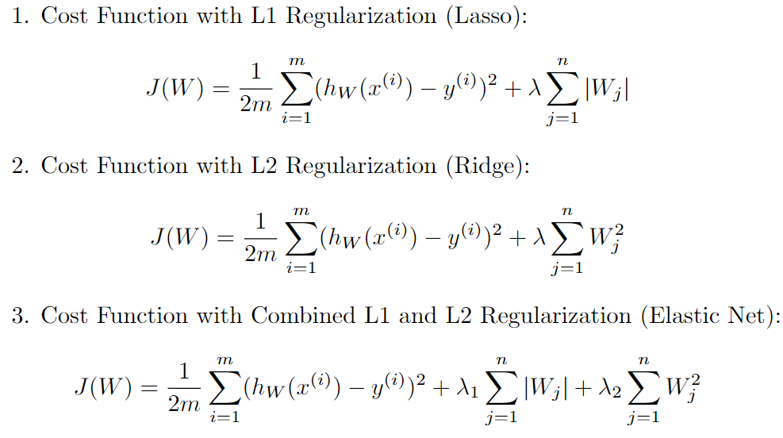
Regularization

Slide 41
Regularization
λ is the regularization strength hyperparameter that controls the amount of regularization applied.
Choosing the right value of λ is critical because a value too high will lead to underfitting, while a value too low will not sufficiently regularize the parameters.
Regularization techniques are integrated into the cost function for penalizing the magnitude of model parameters 𝑊
For managing model complexity and preventing overfitting/Underfitting.

Slide 42
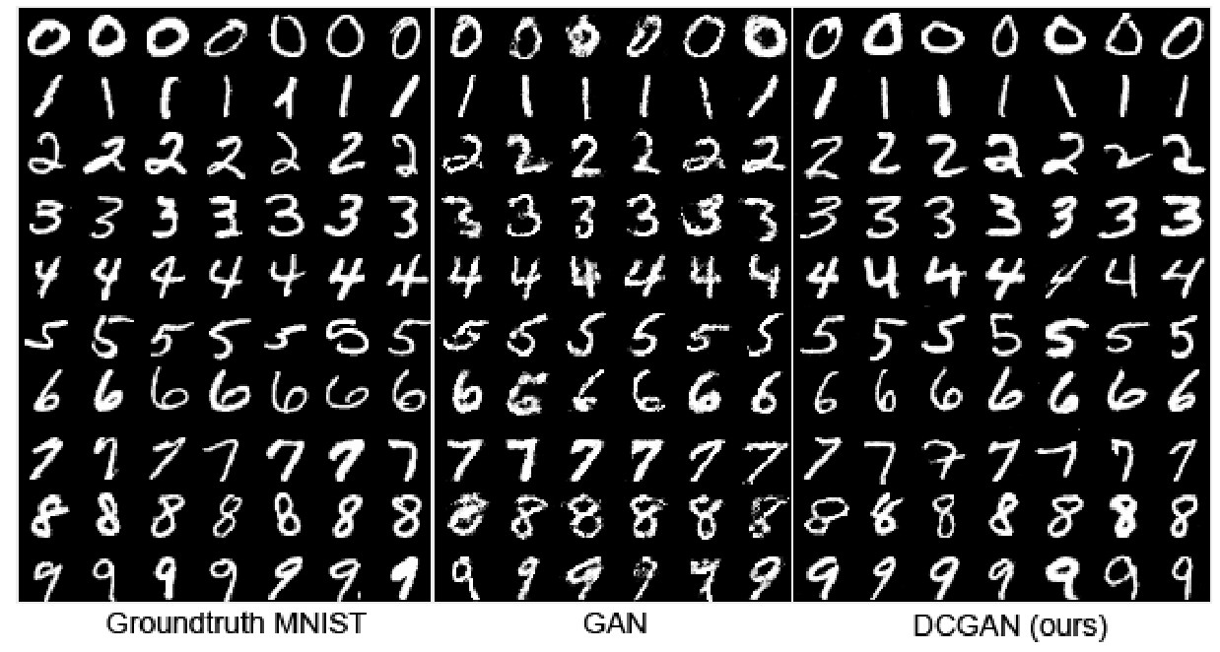
DCGANs Results

Slide 43
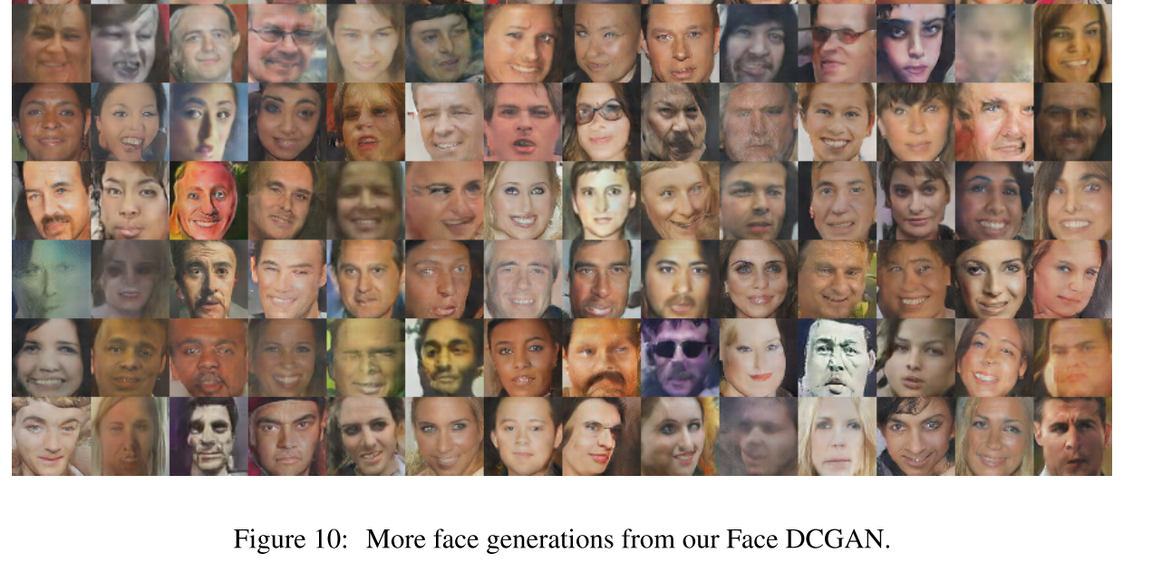
DCGANs Results

Slide 44
Guidelines for DCGANs
Architecture guidelines for stable Deep Convolutional GANs
Replace any pooling layers with strided convolutions (discriminator) and fractional-strided convolutions (generator).
Use Batchnorm in both the generator and the discriminator.
Remove fully connected hidden layers for deeper architectures.
Use ReLU activation in generator for all layers except for the output, which uses Tanh.
Use LeakyReLU activation in the discriminator for all layers.

Slide 45
Research Tasks
What is momentum? Explain the use of the Momentum term in Neural Networks.

Slide 46
Thank You ☺

